Slide 1





Solitary M
PDF 2 BOT
Pdf2Bot is a web-app that creates a chatbot on the fly from the document uploaded by the user and will be able to answer any kind of query related to the file.
View demo

Slide 2

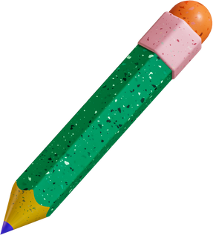


Team
Solitary M
Members
Srinadh vura

Slide 3

Objective
To build a web-app that can successfully create a chatbot from the document provided by the user which can answer any question from the document uploaded.

Slide 4
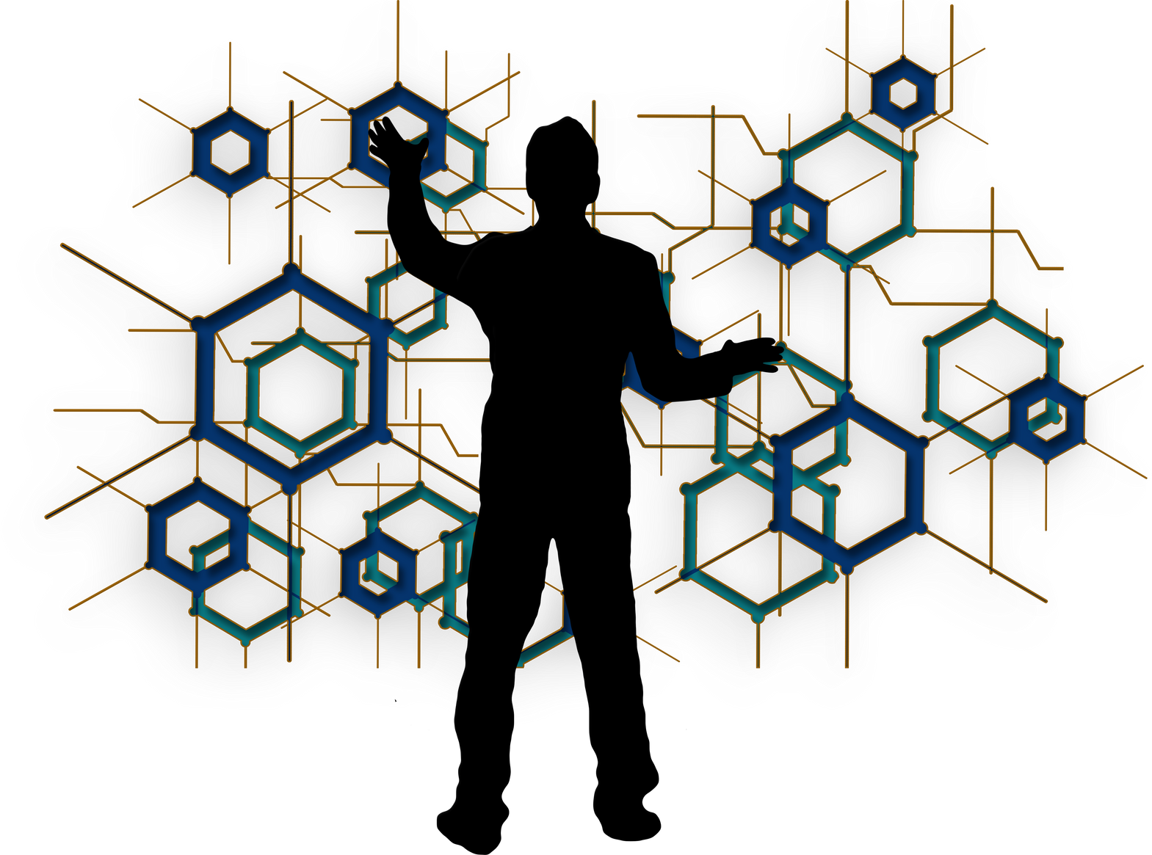
Technologies
Python
Streamlit
Langchain
VertexAI
GTTS
Google Cloud

Slide 5

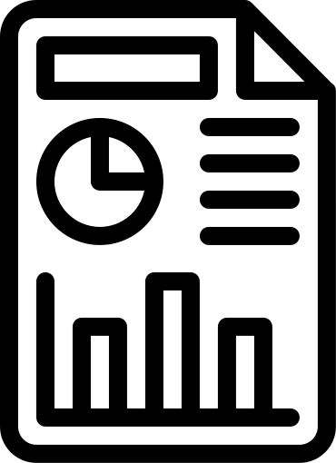


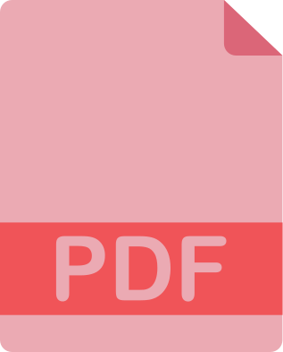







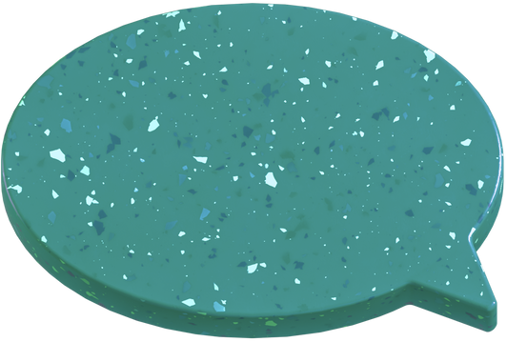
Approach
ANSWER
DATABASE
CHUNKS
DOCUMENT
SPLIT
VECTORIZE
USER
SEMANTIC SEARCH
Query
INPUT

Slide 6







Features
On the fly
Vocal Output
Creates the chatbot required by the user immediately
The bot outputs the result not only in text but also voice
Lucid Interface
Wide support
The web app is easy to use and provides high levels of usability
The app can provide output in seven wiidely accepted english accents
Precise
Applicability
The answers of the bot well matches the information in the document
The Pdf 2 Bot can be used in numerous ways.

Slide 7

Applications
Pdf 2 Bot can be used in numerous ways.
Some of the use cases are
Understand research papers
Summarize long stories
Clearly understand topics from book
Learn the document without actually reading it
Create a bot to support learners.
Parse resume
Understand the agreements to the greatest extent

Slide 8

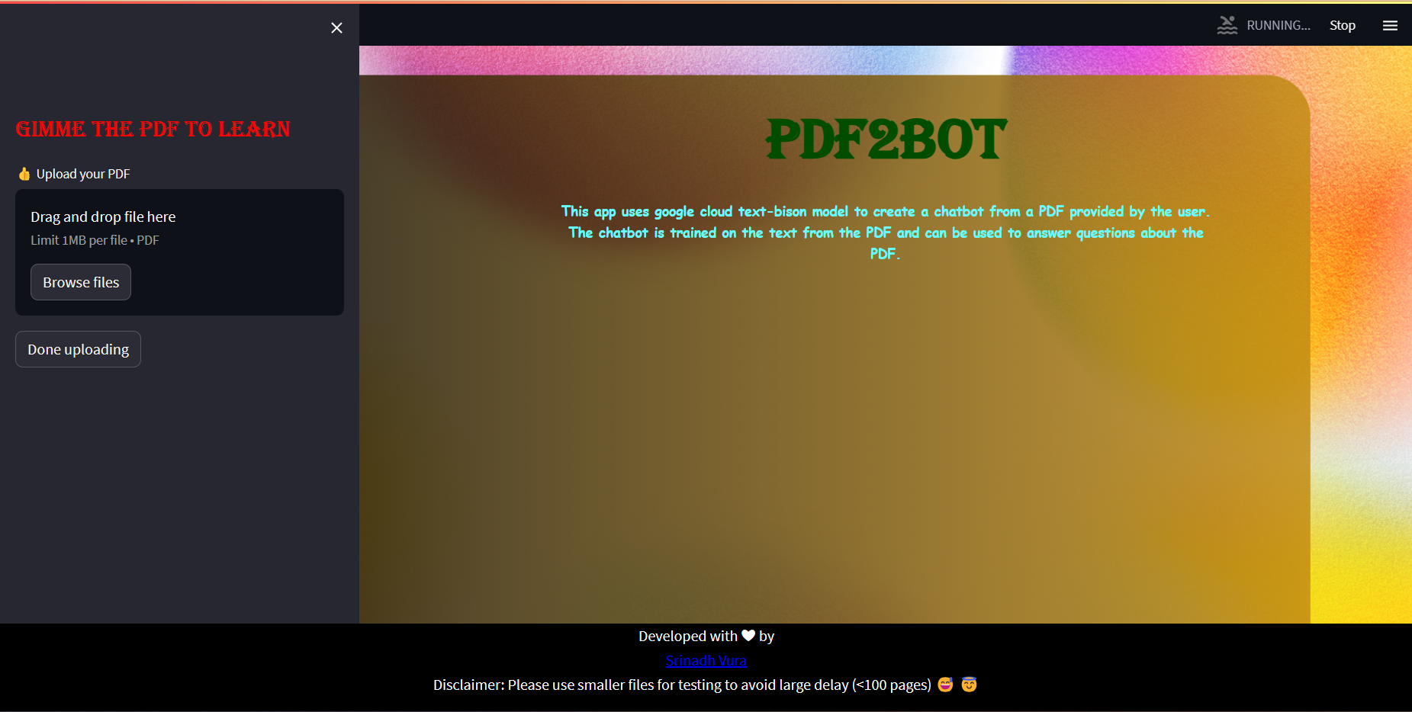
Interface

Slide 9
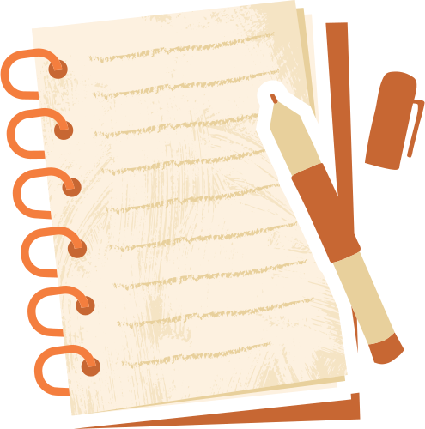
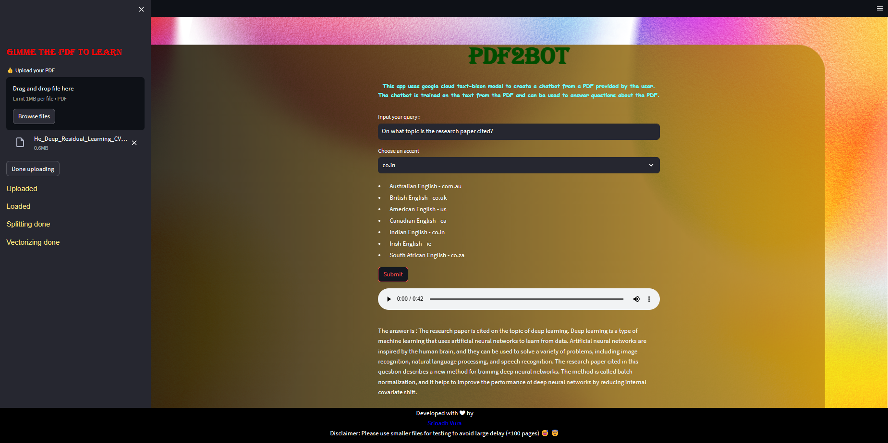
Examples

Slide 10
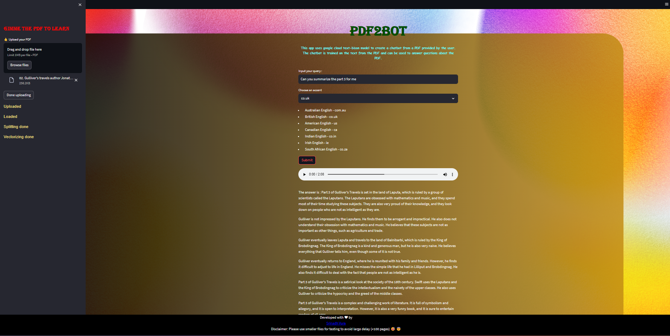

Slide 11





srinadhvura@gmail.com
SrinadhVura

